Slide 1



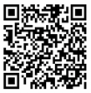

Calibration, Decisions, and Collaboration in Learning
ICML 2026 Tutorial
Natalie Collina
Ira Globus-Harris
Aaron Roth
Penn $→$ MIT
Cornell
Penn
https://calibration-tutorial.github.io/

Slide 2
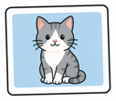
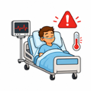

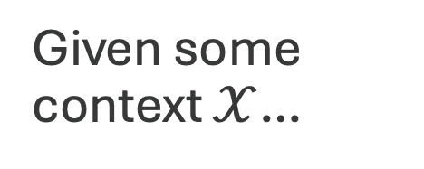
Machine learning is about making predictions
Given some context $𝒳$…
images
patient data
text

Slide 3

Machine learning is about making predictions
Given some context $𝒳$…
can we predict
…the probability the image depicts a cat?

Slide 4
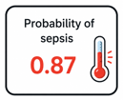
Machine learning is about making predictions
Given some context $𝒳$…
can we predict
…the probability the patient develops sepsis today?

Slide 5
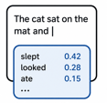
Machine learning is about making predictions
Given some context $𝒳$…
can we predict
…the probability the next word in the text is “slept”?

Slide 6
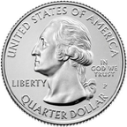

How can we make sense of probabilities?
What is the probability that if I flip a fair coin 16 times I get exactly 9 heads?
  We have a mathematical model that maps well onto reality; we can compute this in closed form.
  We can conduct the experiment repeatedly and empirically estimate probabilities.

Slide 7
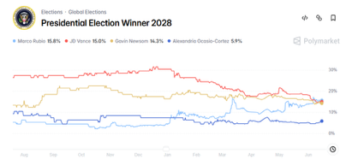

How can we make sense of probabilities?
What is the probability that JD Vance will win the 2028 US Presidential Election?”
If we posit a probabilistic model of the universe, this is perhaps philosophically coherent, but it is not a repeatable event; we can’t get empirical estimates.

Slide 8

How can we make sense of probabilities?
Many things we want to predict are closer to the 2nd example.
  What is the probability of the next token given 50 pages of text?
    There is no two extant texts with the same 50 page prefix...
  What is the probability that Alice develops sepsis in the next 12 hours?
    There are no two patients with exactly the same medical history and sequence of vital readings
  What is the probability of rain in Seoul tomorrow?
    There are no two days with exactly the same atmospheric readings...
  …

Slide 9
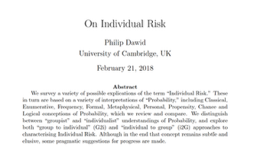
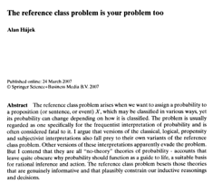
How can we make sense of probabilities?
In general, no way to verify "correctness" of forecasts of "individual probabilities" and unclear they are even philosophically coherent.
  This is the Reference Class Problem from Philosophy of Science, and it pervades machine learning.

Slide 10
So we can’t be sure we’ve learned “true probabilities”…
What are the properties of “true probabilities” that make them useful?
Maybe we can learn those.

Slide 11
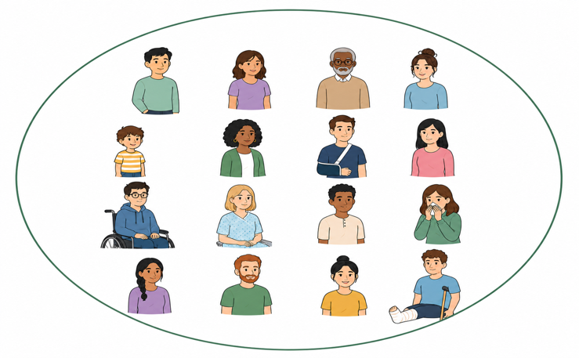
What can we do?
We can always measure averages over subsets of outcomes…
What’s the average patient
outcome
prediction error
prediction bias

Slide 12
What can we do?
We can always measure averages over subsets of outcomes…
What about for these patients?

Slide 13
What can we do?
We can always measure averages over subsets of outcomes…
Or these?

Slide 14
Are we back to predicting individual probabilities?
If we take our subsets to be too small then yes…
Let’s learn on each of these subsets!

Slide 15
Are we back to predicting individual probabilities?
If we take our subsets to be too small then yes…
Let’s learn on each of these subsets!
Luckily, we won’t have to this!

Slide 16
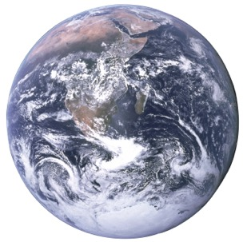

Goal: Predictions which have same useful properties as true probabilities
Indistinguishable!
World where our predictions are correct
Real world

Slide 17
The trick: clever debiasing
Clever debiasing
Make predictions unbiased on the right subsequences

Slide 18



We use clever debiasing to interpret probabilities…
The model predicts only a 0.05% chance of sepsis!
Interpretable
probabilities
Meaningful, trustworthy predictions.

Slide 19
We use clever debiasing to interpret probabilities…
The model predicts only a 0.05% chance of sepsis!
Interpretable
probabilities
Meaningful, trustworthy predictions.
What does this mean for me?

Slide 20

…to give guarantees for downstream decisions…
Based on the model’s predictions, we should try antibiotics!
Good decision-making
Make predictions suited for downstream decisions.

Slide 21
…to give guarantees for downstream decisions…
Based on the model’s predictions, we should try antibiotics!
Good decision-making
Make predictions suited for downstream decisions.
What does this guarantee?

Slide 22
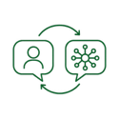
…and to reason about collaborative settings!
Based on the model’s predictions and my own intuition, your sepsis risk is low!
Collaborative learning
Learn efficiently from distributed information.

Slide 23



Clever debiasing is an efficient post-hoc process
Post-hoc + do-no-harm
Already trained your model? That’s okay—you can still use these tools!
Lightweight postprocessing
Efficiently applied to the model you’ve already trained.
Do-no-harm guarantee
The new model will only be better than the one you started with.

Slide 24
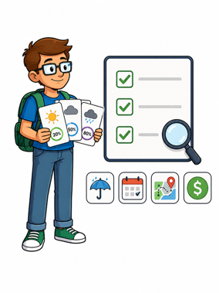
Overarching Goal
Define a collection of simple empirical tests that real probabilities would pass, and are auditable from data.
Learn predictors that pass the tests.
Choose the tests so that they are sufficient for downstream applications.
  i.e. test for the properties of probabilities that are useful.

Slide 25



Roadmap
  A simple hierarchy of tests we can ask for
  Why we can pass these tests (a clever minimax argument)
  Efficient algorithms for passing these tests.
Multicalibration
(and related)
Prediction for downstream decision-making
Learn a single predictor that can be used to simultaneously optimize many downstream utility functions.
Fast multi-party agreement and information aggregation
Let two parties with mutually unintellegible observations (e.g. an AI and a person) interact to get complementary benefits.

Slide 26
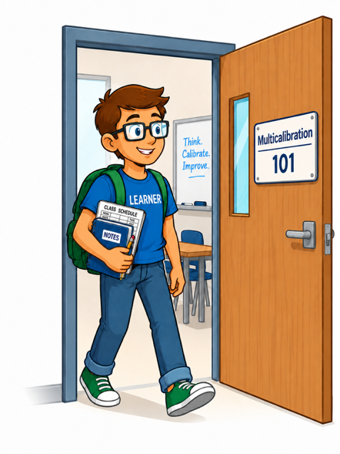
Getting Started
Calibration

Slide 27

What is Calibration [Dawid '82]?
70% sepsis

Slide 28



What is Calibration [Dawid '82]?
70% sepsis
20% sepsis
10% sepsis
50% sepsis
70% sepsis
70% sepsis
20% sepsis
20% sepsis
70% sepsis
70% sepsis
50% sepsis
70% sepsis
20% sepsis
70% sepsis
20% sepsis
50% sepsis
50% sepsis
70% sepsis
10% sepsis
20% sepsis
70% sepsis
70% sepsis

Slide 29
What is Calibration [Dawid '82]?
70% sepsis
70% sepsis
70% sepsis
70% sepsis
70% sepsis
70% sepsis
70% sepsis
70% sepsis
70% sepsis
70% sepsis

Slide 30
What is Calibration [Dawid '82]?
70% sepsis
20% sepsis
10% sepsis
50% sepsis
70% sepsis
70% sepsis
20% sepsis
20% sepsis
70% sepsis
70% sepsis
50% sepsis
70% sepsis
20% sepsis
70% sepsis
20% sepsis
50% sepsis
50% sepsis
70% sepsis
10% sepsis
20% sepsis
70% sepsis
70% sepsis

Slide 31
What is Calibration [Dawid '82]?
20% sepsis
20% sepsis
20% sepsis
20% sepsis
20% sepsis
20% sepsis

Slide 32
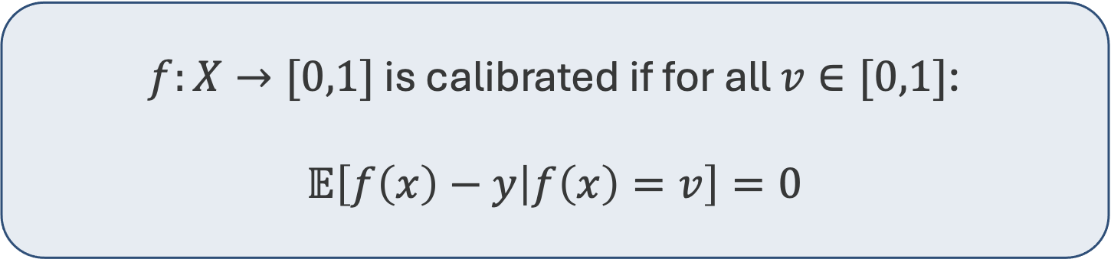

Calibration: Self-Referential Consistency
[Dawid '82]
Fix a distribution $𝒟$ on labeled examples $𝒟∈Δ(X×\left\{0,1\right\})$.
Calibration asks that predictions be statistically unbiased conditional on the predictions themselves. In one dimension:
$f:X→[0,1]$ is calibrated if for all $v∈[0,1]$:
$$𝔼\left[f\left(x\right)−y | f\left(x\right)=v\right]=0$$

Slide 33
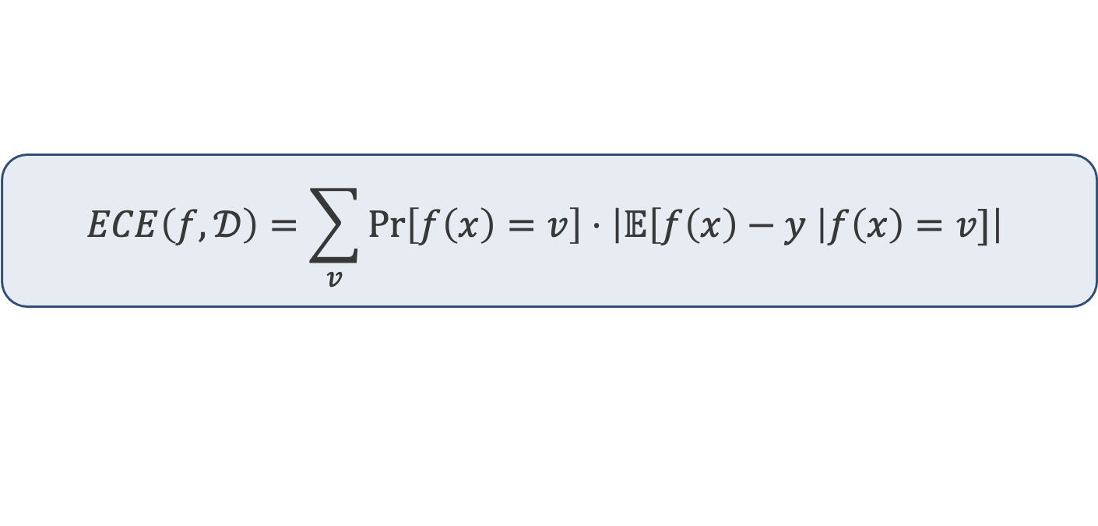
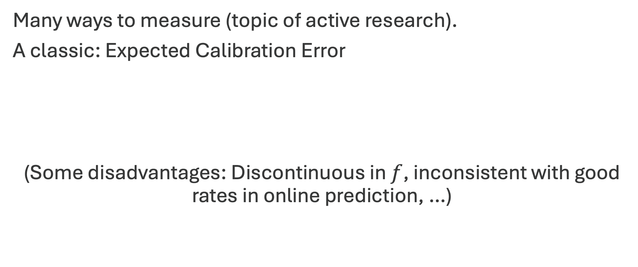
Approximate Calibration Error?
Many ways to measure (topic of active research).
A classic: Expected Calibration Error
(Some disadvantages: Discontinuous in $f$, inconsistent with good rates in online prediction, …)
$$ECE\left(f,𝒟\right)=\sum_{v}{\operatorname{Pr}\left[f\left(x\right)=v\right]⋅\left|𝔼\left[f\left(x\right)−y \right|f\left(x\right)=v]\right|}$$

Slide 34
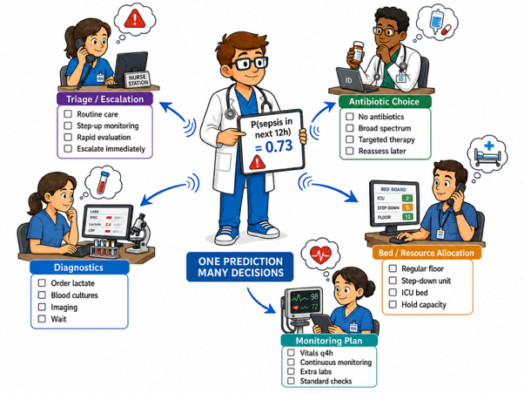
Calibration Instills Trust in Predictions

Slide 35
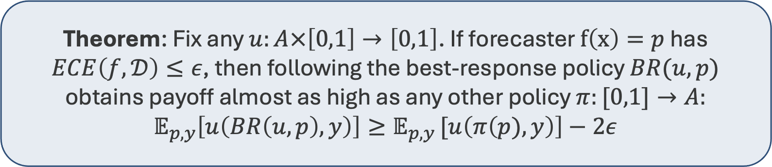

Calibration Instills Trust in Predictions
$$u\left(a,p\right)=p⋅u\left(a,1\right)+\left(1−p\right)⋅u(a,0)$$
$$BR\left(u,p\right)=\arg{\max_{a}{u(a,p)}}$$
“Can’t do better than to trust the predictions”
Theorem: Fix any $u:A×\left[0,1\right]→\left[0,1\right]$. If forecaster $f\left(x\right)=p$ has $ECE\left(f,𝒟\right)≤ε$, then following the best-response policy $BR(u,p)$ obtains payoff almost as high as any other policy $π:[0,1]→A:$
$$𝔼_{p,y}\left[u\left(BR\left(u,p\right),y\right)\right]≥𝔼_{p,y }[u\left(π\left(p),y\right)\right]−2ε$$

Slide 36


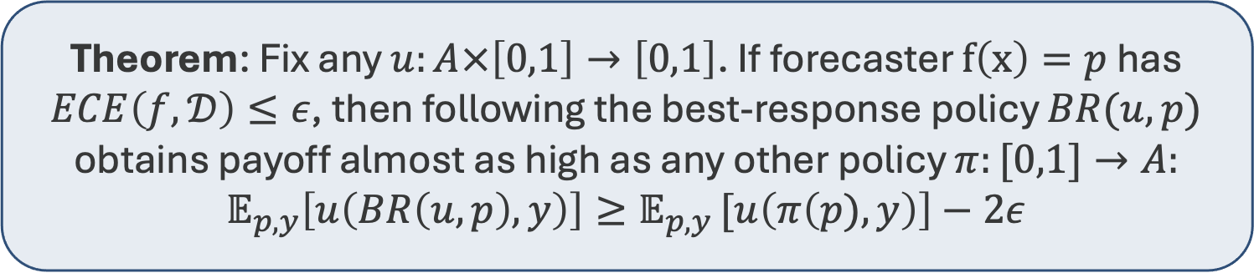
Calibration Instills Trust in Predictions
Theorem: Fix any $u:A×\left[0,1\right]→\left[0,1\right]$. If forecaster $f\left(x\right)=p$ has $ECE\left(f,𝒟\right)≤ε$, then following the best-response policy $BR(u,p)$ obtains payoff almost as high as any other policy $π:[0,1]→A:$
$$𝔼_{p,y}\left[u\left(BR\left(u,p\right),y\right)\right]≥𝔼_{p,y }[u\left(π\left(p),y\right)\right]−2ε$$
Proof:
$𝔼_{p}\left[𝔼_{y}\left[u(BR\left(u,p\right),y)|p\right]\right]$
Real world
$=𝔼_{p}\left[u\left(BR\left(u,p\right),𝔼\left[y | p\right]\right)\right]$
$≥𝔼_{p}\left[u\left(BR\left(u,p\right),p\right)\right]−ε$
Optimistica
$≥𝔼_{p}\left[u\left(π\left(p\right),p\right)\right]−ε$
$=𝔼_{p,y }\left[u\left(π(p),y \right)\right]−2ε$
Real world

Slide 37
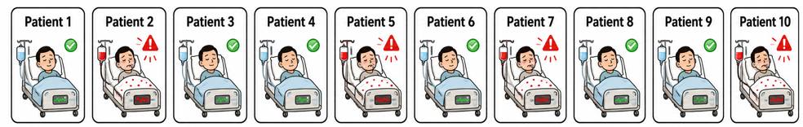

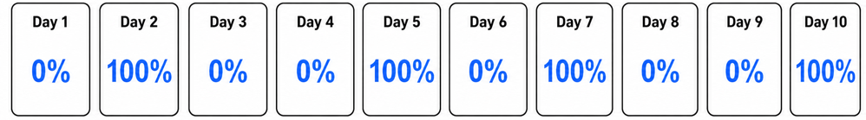


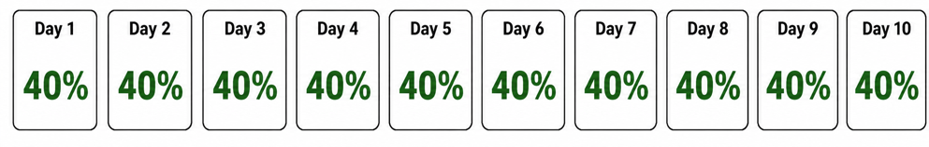
But wait! Calibration Alone is Weak.
Average Frequency of Sepsis: 40%
There are many ways to be calibrated. Here are two.

Slide 38
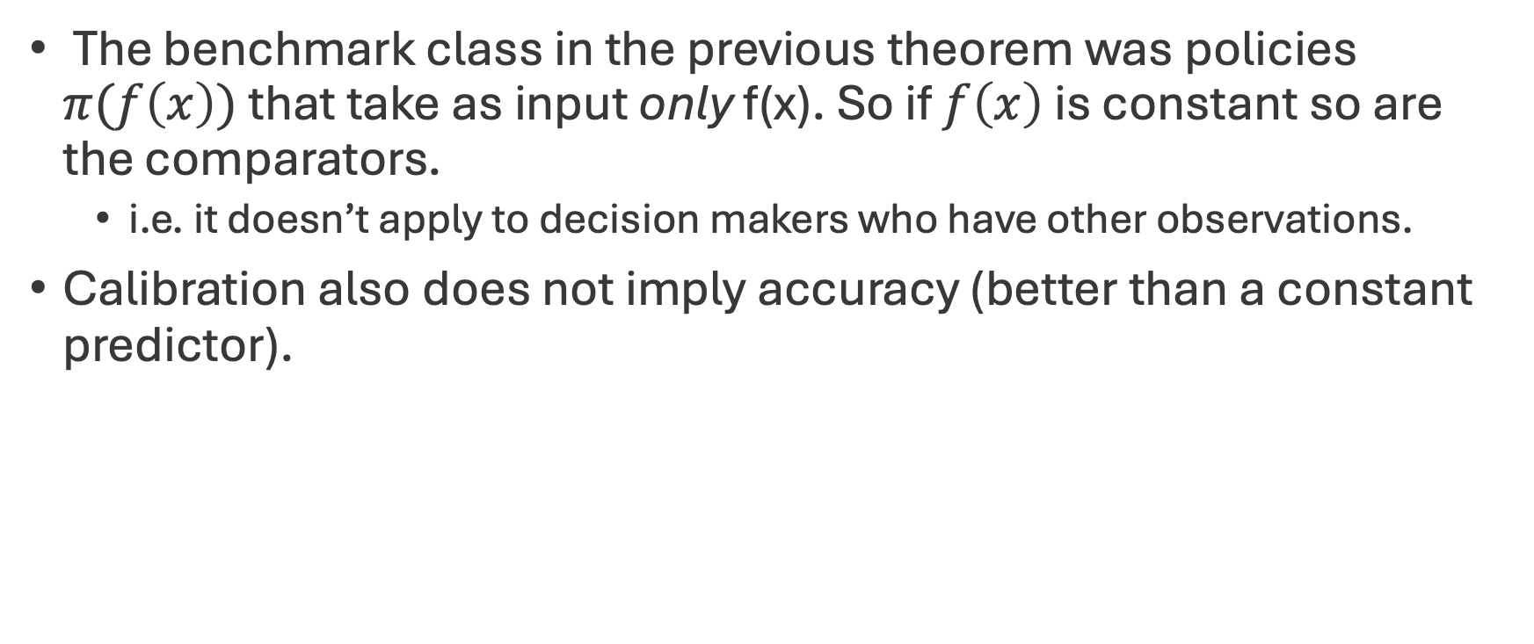
The Catch
The benchmark class in the previous theorem was policies $π(f\left(x\right))$ that take as input only f(x). So if $f\left(x\right)$ is constant so are the comparators.
  i.e. it doesn’t apply to decision makers who have other observations.
Calibration also does not imply accuracy (better than a constant predictor).
So calibration is a minimal desirable property, but we want more.

Slide 39
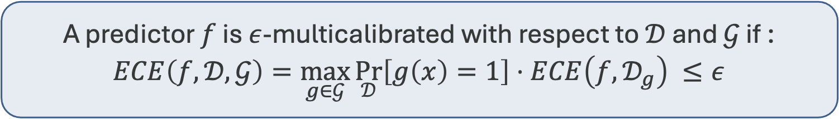

Multicalibration
[Hebert-Johnson, Kim, Reingold, Rothblum, ICML ‘18]
We can ask for calibration conditional on external context.
Fix a collection of grouping functions $𝒢=\{g_{1},…,g_{k}\}$, $g_{i}:X→\left\{0,1\right\}$
Let $𝒟_{g}=𝒟_{|\left(g\left(x\right)=1\right)}$ .
A predictor $f$ is $ε$-multicalibrated with respect to $𝒟$ and $𝒢$ if :
$$ECE\left(f,𝒟,𝒢\right)=\max_{g∈𝒢}{\underset{𝒟}{Pr}\left[g\left(x\right)=1\right]⋅ECE\left(f,𝒟_{g}\right)} ≤ε$$

Slide 40
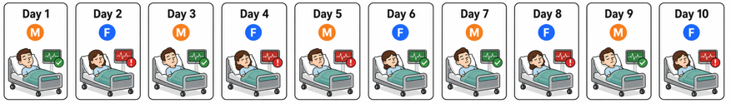
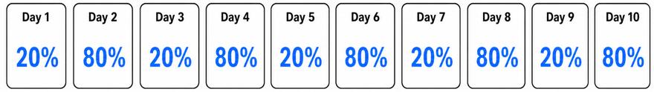
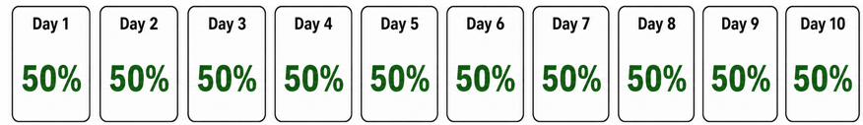

Multicalibration
Suppose we can now observe clinically relevant features.
Overall frequency of sepsis: 50%. For female patients: 80%. For male patients: 20%

Slide 41
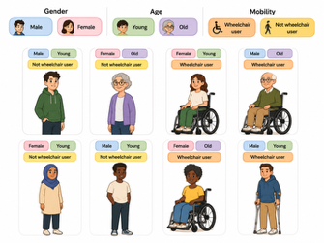
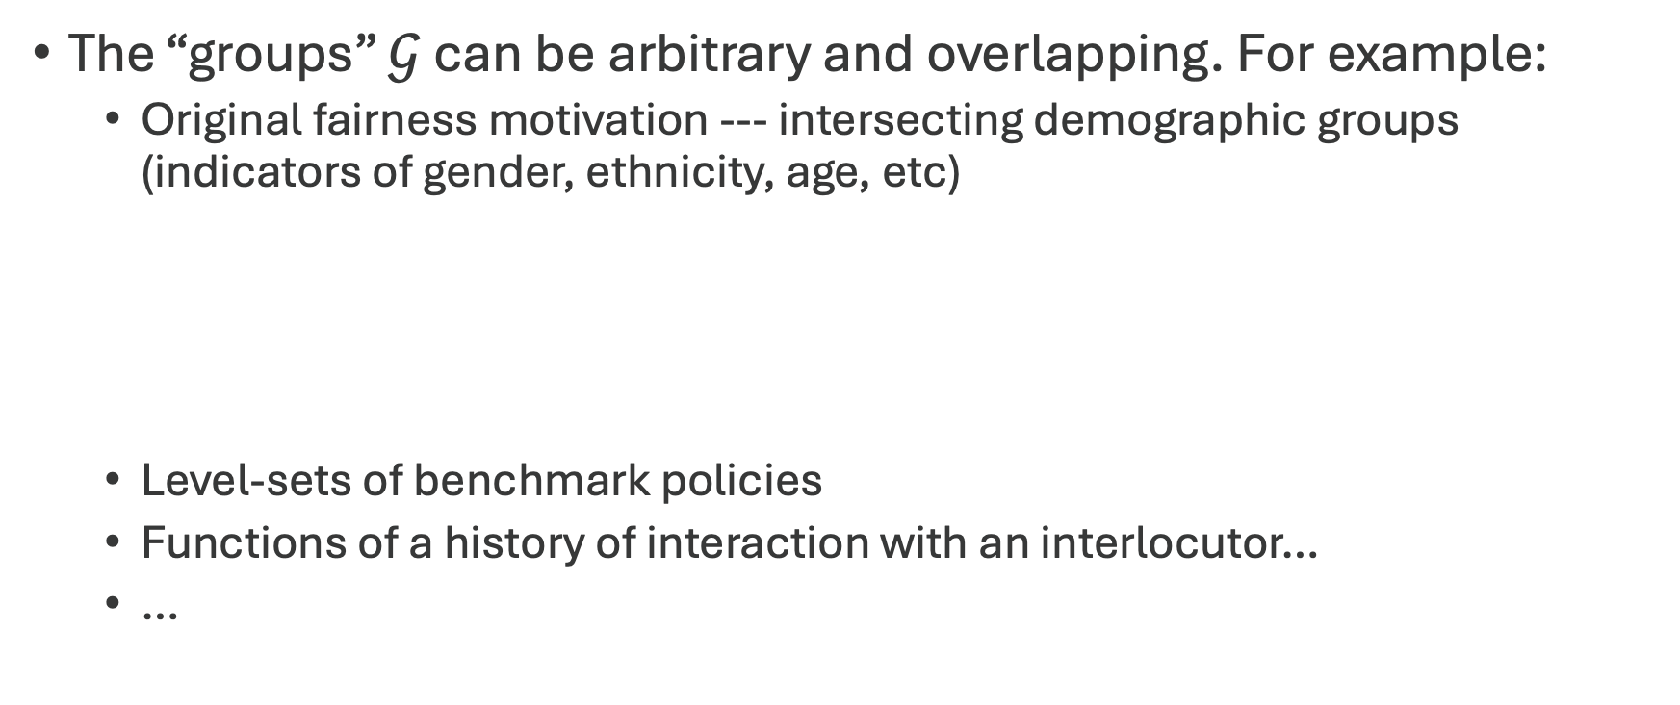
Multicalibration
[Hebert-Johnson, Kim, Reingold, Rothblum, ICML ‘18]
The “groups” $𝒢$ can be arbitrary and overlapping. For example:
  Original fairness motivation --- intersecting demographic groups (indicators of gender, ethnicity, age, etc)
  Level-sets of benchmark policies
  Functions of a history of interaction with an interlocutor…
  …

Slide 42
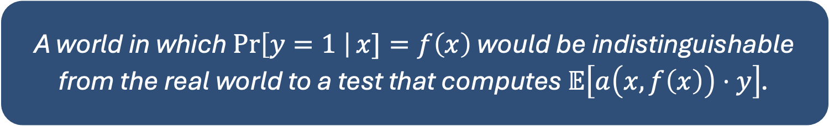

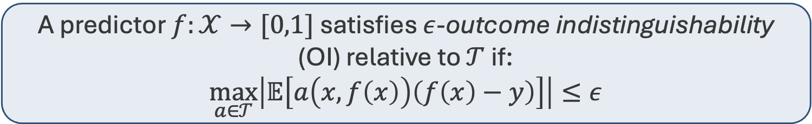
More generally… Outcome Indistinguishability
[Dwork, Kim, Reingold, Rothblum, Yona ‘21]
Fix a collection of tests $𝒯$, where each test $a∈𝒯$ has the form: $a:𝒳×\left[0,1\right]→[−1,1]$
A predictor $f:𝒳→[0,1]$ satisfies $ε$-outcome indistinguishability (OI) relative to $𝒯$ if:
$$\max_{a∈𝒯}\left|𝔼\left[a\left(x,f\left(x\right)\right)\left(f\left(x\right)−y\right)\right]\right|≤ε$$
A world in which $\operatorname{Pr}\left[y=1 \right|x]=f\left(x\right)$ would be indistinguishable from the real world to a test that computes $𝔼\left[a\left(x,f\left(x\right)\right)⋅y\right]$.

Slide 43
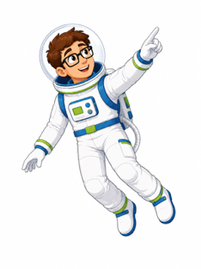
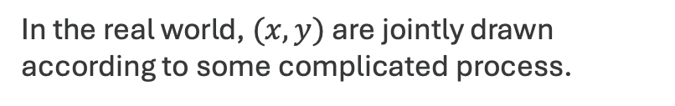
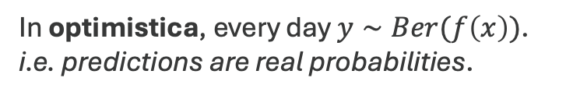
Outcome Indistinguishability
In the real world, $(x,y)$ are jointly drawn according to some complicated process.
In optimistica, every day $y∼Ber(f\left(x\right))$.
i.e. predictions are real probabilities.
Optimistica
Real world
Goal: The Real World and Optimistica should be indistinguishable to tests $𝔼\left[a\left(x,f\left(x\right)\right)y\right]$.

Slide 44
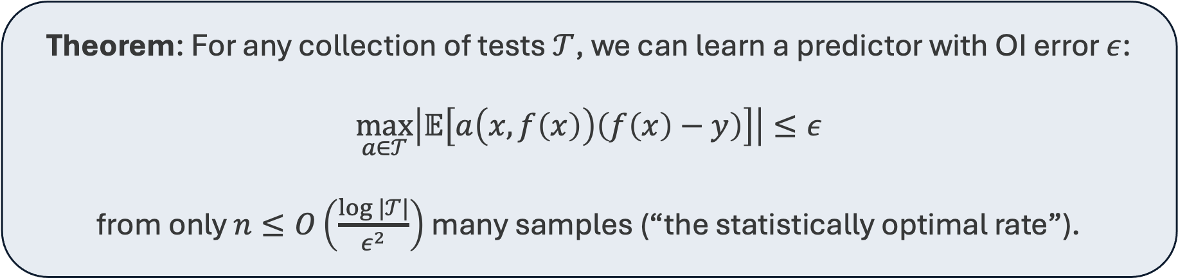
Outcome Indistinguishability is statistically/computationally feasible.
Theorem: For any collection of tests $𝒯$, we can learn a predictor with OI error $ε$:
$$\max_{a∈𝒯}\left|𝔼\left[a\left(x,f\left(x\right)\right)\left(f\left(x\right)−y\right)\right]\right|≤ε$$
from only $n≤O\left(\frac{\log{|𝒯|}}{ε^{2}}\right)$ many samples (“the statistically optimal rate”).
And we can do this even in the sequential adversarial setting.
Modelling, e.g., arbitrary distribution shift.

Slide 45
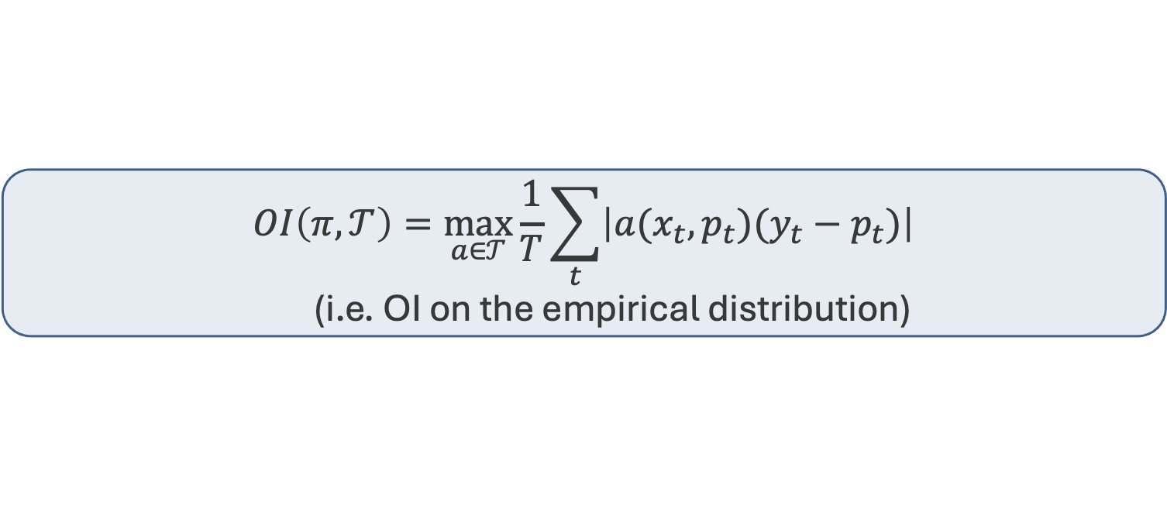
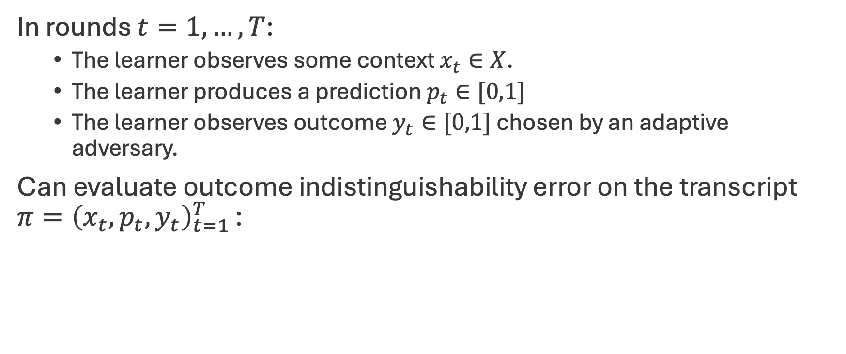
The Sequential/Adversarial Prediction Setting
In rounds $t=1,…,T$:
  The learner observes some context $x_{t}∈X$.
  The learner produces a prediction $p_{t}∈[0,1]$
  The learner observes outcome $y_{t}∈[0,1]$ chosen by an adaptive adversary.
Can evaluate outcome indistinguishability error on the transcript $π={\left(x_{t},p_{t},y_{t}\right)}_{t=1 }^{T}$:
$$OI\left(π,𝒯\right)=\max_{a∈𝒯}{\frac{1}{T}\sum_{t}{\left|a(x_{t},p_{t})(y_{t}−p_{t})\right|}}$$
  (i.e. OI on the empirical distribution)

Slide 46
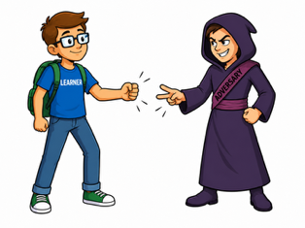
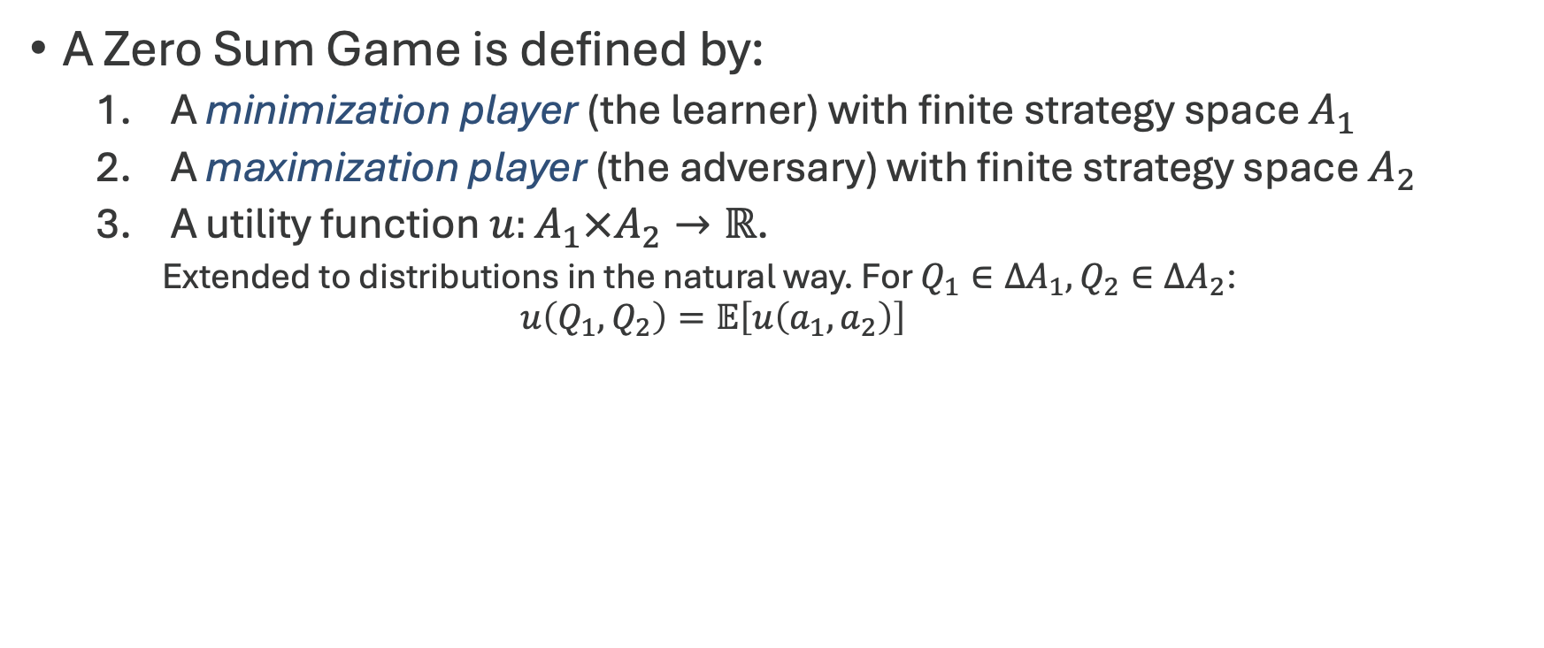
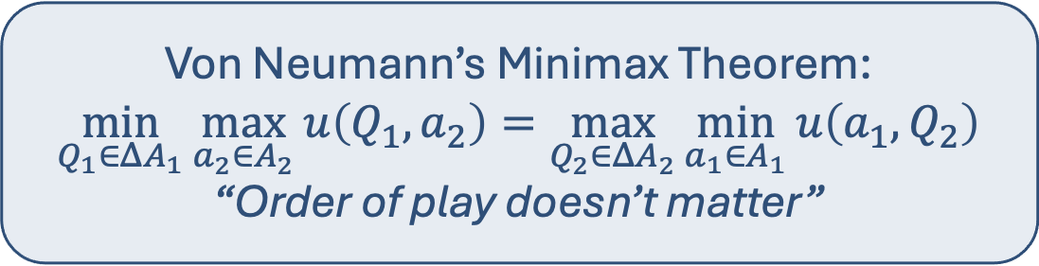
An Interlude: Zero Sum Games
A Zero Sum Game is defined by:
  A minimization player (the learner) with finite strategy space $A_{1}$
  A maximization player (the adversary) with finite strategy space $A_{2}$
  A utility function $u:A_{1}×A_{2}→ℝ$.
    Extended to distributions in the natural way. For $Q_{1}∈ΔA_{1},Q_{2}∈ΔA_{2}$:
    $$u\left(Q_{1},Q_{2}\right)=𝔼\left[u\left(a_{1},a_{2}\right)\right]$$
Von Neumann’s Minimax Theorem:
$$\min_{Q_{1}∈ΔA_{1}}{\max_{a_{2}∈A_{2}}{u\left(Q_{1},a_{2}\right)}}=\max_{Q_{2}∈ΔA_{2}}{\min_{a_{1}∈A_{1}}{u\left(a_{1},Q_{2}\right)}}$$
“Order of play doesn’t matter”

Slide 47
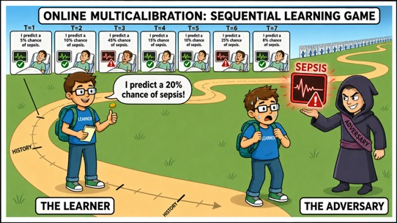
Where does the optimal rate come from?
Sequential learning is a zero-sum game played against an adversary.
The learner must go first (commit to an algorithm) and give guarantees against all adversary strategies.

Slide 48
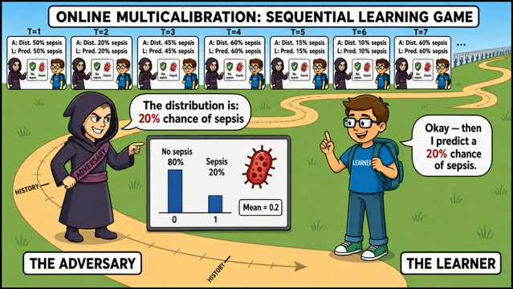
Where does the optimal rate come from?
But by the minimax theorem (must verify conditions), the value of the game is the same as in the (seemingly) much easier scenario in which the adversary goes first and the learner gets to respond.

Slide 49
Where does the optimal rate come from?
Unsurprisingly, when the learner knows the distribution, they can satisfy OI constraints at the statistically optimal rate.
Amazingly (!) by the minimax theorem, there is an algorithm that guarantees they do just as well in adversarial environments.
Nonconstructive!
The game we are applying the minimax argument to has strategy spaces corresponding to all possible algorithms.

Slide 50


The trick: clever debiasing
Clever debiasing
Make predictions unbiased on the right subsequences
Efficient
&
Does no harm!
Interpretable
probabilities
Meaningful, trustworthy predictions.
Good decision-making
Use predictions well for downstream decisions.
Collaborative learning
Learn efficiently from distributed information.

Slide 51
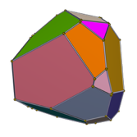
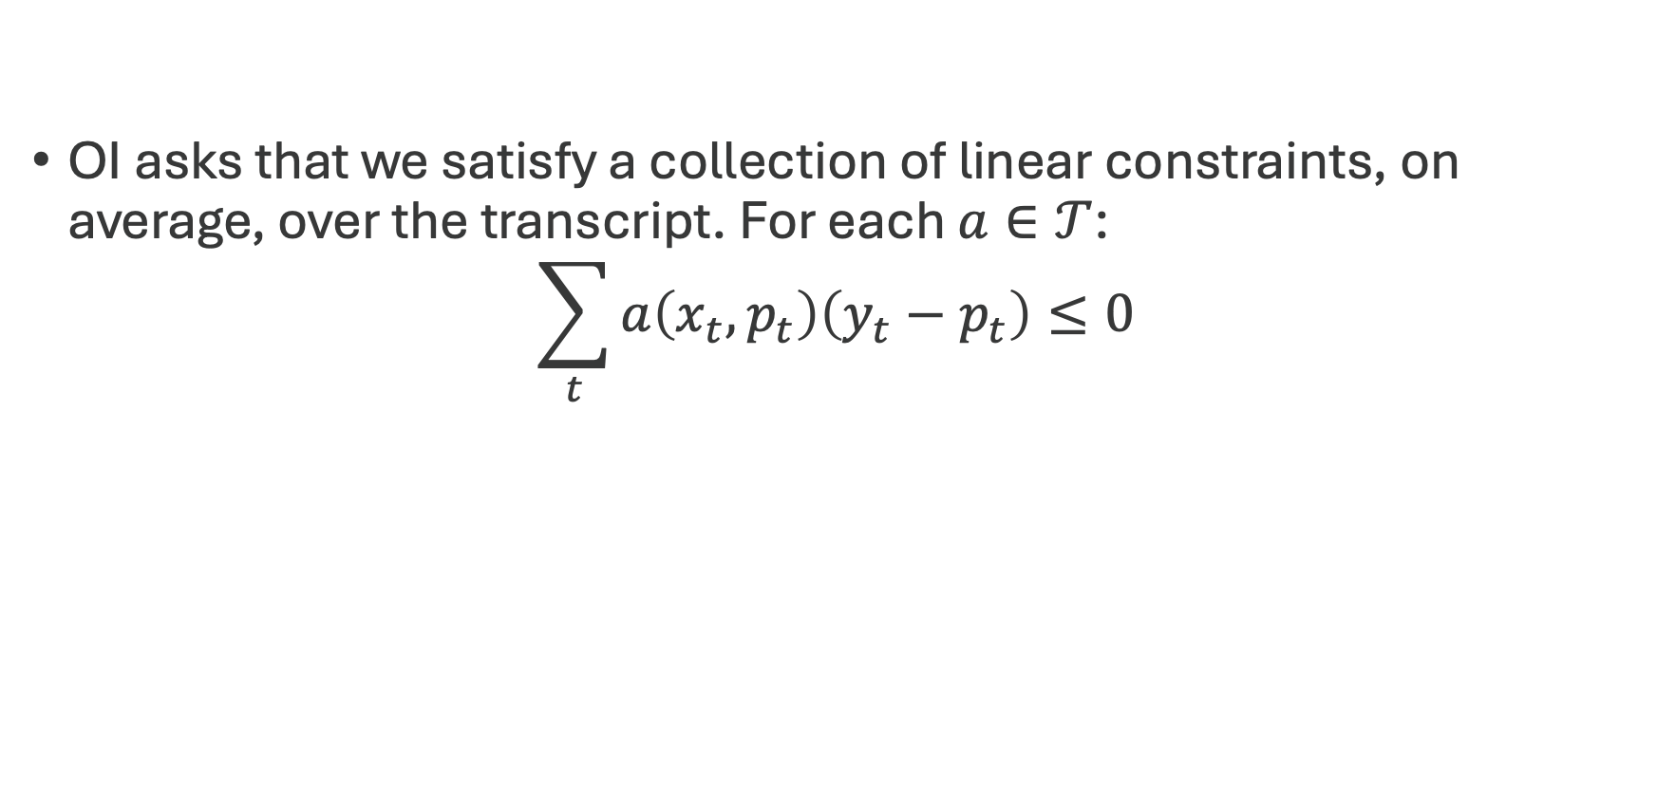

Making the Algorithm Efficient
OI asks that we satisfy a collection of linear constraints, on average, over the transcript. For each $a∈𝒯$:
$$\sum_{t}{a\left(x_{t},p_{t}\right)\left(y_{t}−p_{t}\right)}≤0$$
The time average of $a\left(x_{t},p_{t}\right)\left(y_{t}−p_{t}\right)$ should approach a polytope.
  A “Blackwell Approachability” problem.

Slide 52


Making the Algorithm Efficient
Say a hater is betting against you, hoping you fail.
They are running a “no-regret” algorithm maintaining a distribution $w^{t}$ over tests $a∈𝒯$.
Each round, if your hater bet on test $a∈T$ their joy would be $a(x_{t},p_{t})(y_{t}−p_{t})$, your violation of that test constraint.
Since the hater hedges:
Your Hater’s Joy at round $t$ = $𝔼_{{a∼w}^{t}}\left[a\left(x_{t},p_{t}\right)(y_{t}−p_{t})\right]$

Slide 53


Making the Algorithm Efficient
Since they are running a no regret algorithm they are guaranteed near optimal joy.
Your Biggest Failure = $\max_{a∈𝒯}{\frac{1}{T}\sum_{t}{a\left(x_{t},p_{t}\right)⋅\left(y_{t}−p_{t}\right)}}$
Your Hater’s Average Joy $≥$ Your Biggest Failure $−\sqrt{\frac{\log{|𝒯|}}{T}}$
.
Algorithmic Strategy:
Play so as to minimize your hater’s joy

Slide 54



Making the Algorithm Efficient
Let:
$q_{t}=\arg{\min_{q∈Δ[0,1]}{\max_{y}{𝔼_{p_{t}∼q}\left[\text{Your} \text{Haters} \text{Joy}\right]}}}$
Your Hater’s Joy = $𝔼_{{a∼w}^{t}}\left[a\left(x_{t},p_{t}\right)(y_{t}−p_{t})\right]$
If you knew $𝔼[y]$ you could always set $p=𝔼[y]$
and guarantee your hater 0 expected joy….
Selecting $p_{t}∼q_{t}$ also guarantees your hater 0 expected joy.

Slide 55



Making the Algorithm Efficient
Since
$0=𝔼[$Your hater’s joy]
$$≥\text{Your} \text{Biggest} \text{Failure}−\sqrt{\frac{\log{|𝒯|}}{T}}$$
It must be that after $T$ rounds…
.
$$OI\left(π,𝒯\right)≤\sqrt{\frac{\log{|𝒯|}}{T}}$$
Or equivalently, $OI\left(π,𝒯\right)≤ε$ if $T≥\frac{\log\left|𝒯\right|}{ε^{2}}$

Slide 56


The final online adversarial algorithm
Given: A set of tests $𝒯$
Initialize a no regret algorithm with actions $𝒯$.
For $t=1 to T$:
  Let $w^{t}$ be the distribution maintained by the no regret algorithm.
  Let $J\left(p,y\right)=𝔼_{a∼w^{t}}\left[a\left(x_{t},p\right)⋅(y−p)\right]$
  Let $q_{t}=\arg{\min_{q∈Δ[0,1]}{𝔼_{p∼q}\left[J\left(p,y\right)\right]}}$ (A linear program)
  Play $p_{t}∼q_{t}$
  Feed the algorithm gain $a\left(x_{t},p_{t}\right)⋅(y_{t}−p_{t})$ for each test $a∈𝒯$.

Slide 57

Online to Batch Reduction
This obtains optimal sample complexity $O\left(\frac{\log\left|𝒯\right|}{ε^{2}}\right)$

Slide 58



How does multicalibration fit?
Suppose our predictions lie on a grid $Λ=\left\{0,\frac{1}{m},\frac{2}{m}, …, 1\right\}$
This is OI for the class $𝒯_{mcal(𝒢)}={\left\{a_{g,σ}\left(x_{t},p_{t}\right)=g\left(x\right)⋅σ\left(p_{t}\right)\right\}}_{g, σ}$
$$ECE\left(π,𝒢\right)=\max_{g∈𝒢}{\frac{1}{T}\sum_{v∈Λ}{\left|\sum_{t}{1\left[p_{t}=v\right]⋅1[g\left(x_{t}\right)=1](y_{t}−p_{t})}\right|}}$$
Dual view:
$$ECE\left(π, 𝒢\right)=\max_{g∈𝒢, σ:Λ→\{−1,1\}}{\frac{1}{T}}\sum_{t}{σ\left(p_{t}\right)⋅1[g\left(x_{t}\right)=1](y_{t}−p_{t})}$$

Slide 59

How does multicalibration fit?
Lower Bound [Collina, Liu, Noarov, Roth ‘26]
Learning a multicalibrated predictor requires $\tilde{Θ}\left(\frac{1}{ε^{3}}\right)$ samples.
Worse: for $k$-class outcomes it requires $\tilde{Θ}\left(\frac{1}{ε^{k+1}}\right)$ samples.
The issue: too many tests!
Fortunately, fewer OI tests often suffice.

Slide 60



Complicating the Running Example
Sepsis/no sepsis
Patient’s future clinical trajectory
Vitals, laboratory values, organ function, and infection indicators over the next 24 hours
This requires being OI with respect to a lot of tests!

Slide 61

Downstream Decisions
But even if the prediction is very complex, the actions it may induce can be simpler
If the main goal is good downstream decisions, then can we use less tests?

Slide 62
The trick: clever debiasing
Clever debiasing
Make predictions unbiased on the right subsequences
Efficient
&
Does no harm!
Interpretable
probabilities
Meaningful, trustworthy predictions.
Good decision-making
Use predictions well for downstream decisions.
Collaborative learning
Learn efficiently from distributed information.

Slide 63
The trick: clever debiasing
Clever debiasing
Make predictions unbiased on the right subsequences
Efficient
&
Does no harm!
Interpretable
probabilities
Meaningful, trustworthy predictions.
Good decision-making
Use predictions well for downstream decisions.
Collaborative learning
Learn efficiently from distributed information.

Slide 64




What Makes a Decision “good?”
Say the doctor has some utility function $u(a,y)$ mapping from the state $y$ and action $a$
Let $d\left(f\left(x\right)\right)$ be the decision rule which chooses action
$$a∈\arg{\max{u(a,f(x))}}$$
Goal: ensure that the decision maker has no swap regret if they follow the predictions

Slide 65












Interlude: Swap Regret
Measures how much a decision-maker can improve by swapping all times they played one action with another action

Slide 66
Interlude: Swap Regret
Measures how much a decision-maker can improve by swapping all times they played one action with another action

Slide 67
Interlude: Swap Regret
If a decision maker has no swap regret, then on average on the instances they prescribed antibiotics, this was the best action

Slide 68
Interlude: Swap Regret
If a decision maker has no swap regret, then on average on the instances they prescribed antibiotics, this was the best action

Slide 69
Interlude: Swap Regret
If a decision maker has no swap regret, then on average on the instances they prescribed antibiotics, this was the best action

Slide 70
Interlude: Swap Regret
If a decision maker has no swap regret, then on average on the instances they applied a cast, this was the best action

Slide 71
Interlude: Swap Regret
If a decision maker has no swap regret, then on average on the instances they performed surgery, this was the best action

Slide 72



What OI tests do we really need to pass here?
In the real world, $(x,y)$ are jointly drawn according to some complicated process.
In optimistica, every day $y∼Ber(f\left(x\right))$.
i.e. predictions are real probabilities.
Real world
Optimistica
Goal: The Real World and Optimistica should be Indistinguishable to Statistics $𝔼\left[a\left(x,f\left(x\right)\right)y\right]$.

Slide 73


What OI tests do we really need to pass here?
In the real world, $(x,y)$ are jointly drawn according to some complicated process.
In optimistica, every day $y∼Ber(f\left(x\right))$.
i.e. predictions are real probabilities.
$d\left(f\left(x\right)\right)$ is the decision rule which chooses action
$$a∈\arg{\max{u(a,f(x))}}$$
In other words, we don’t require our predictions to be fully calibrated overall anymore—just unbiased on the doctor’s best-response regions
Optimistica
Real world
For no swap regret on downstream decisions: The Real World and Optimistica should be indistinguishable to $𝔼[1\left\{d\left(f\left(x\right)\right)=a\right\}y]$ for all $a$.

Slide 74



Decision Calibration
For no swap regret on downstream decisions: The Real World and Optimistica should be indistinguishable to $𝔼[1\left\{d\left(x,f\left(x\right)\right)=j\right\}y]$ for all $j$.
Based on the information the algorithm has given me, the best choice of action is to increase antibiotics ($d\left(x,f\left(x\right)\right)=antibiotics$)
Does this mean I should increase antibiotics?
antibiotics
antibiotics
Well, in Optimistica, I certainly should.
And in aggregate over instances where $d\left(x,f\left(x\right)\right)=antibiotics$, we cannot distinguish between Optimistica and the real world
So the expected utility of antibiotics is the same in both settings
Furthermore, the expected utility of the other actions are also the same!
Optimistica
Real World

Slide 75
Getting Decision Calibration
For no swap regret on downstream decisions: The Real World and Optimistica should be indistinguishable to $𝔼[1\left\{d\left(x,f\left(x\right)\right)=j\right\}y]$ for all $j$.
Simply an application of the OI algorithm, with the |A| tests above!

Slide 76

But wait…
I already have a great model that gets pretty good accuracy and uses lots of complicated techniques. Are you telling me to throw it away?
No! You can get all of our guarantees on top of your own model’s performance

Slide 77
The trick: clever debiasing
Clever debiasing
Make predictions unbiased on the right subsequences
Efficient
&
Does no harm!
Interpretable
probabilities
Meaningful, trustworthy predictions.
Good decision-making
Use predictions well for downstream decisions.
Collaborative learning
Learn efficiently from distributed information.

Slide 78
The trick: clever debiasing
Clever debiasing
Make predictions unbiased on the right subsequences
Efficient
&
Does no harm!
Interpretable
probabilities
Meaningful, trustworthy predictions.
Good decision-making
Use predictions well for downstream decisions.
Collaborative learning
Learn efficiently from distributed information.

Slide 79

Warm-up: Post-hoc calibration on your favorite predictor
90% sepsis

Slide 80
Warm-up: Post-hoc calibration on your favorite predictor
Post-hoc calibration
90% sepsis
80% sepsis

Slide 81










Warm-up: Post-hoc calibration on your favorite predictor
70% sepsis
20% sepsis
90% sepsis
70% sepsis
20% sepsis
20% sepsis
70% sepsis
70% sepsis
90% sepsis

Slide 82
Warm-up: Post-hoc calibration on your favorite predictor
70% sepsis
20% sepsis
90% sepsis
70% sepsis
20% sepsis
20% sepsis
70% sepsis
70% sepsis
90% sepsis
Feed these instances into one calibration algorithm

Slide 83
Warm-up: Post-hoc calibration on your favorite predictor
70% sepsis
20% sepsis
90% sepsis
70% sepsis
20% sepsis
20% sepsis
70% sepsis
70% sepsis
90% sepsis
Feed these instances into another

Slide 84
Warm-up: Post-hoc calibration on your favorite predictor
70% sepsis
20% sepsis
90% sepsis
70% sepsis
20% sepsis
20% sepsis
70% sepsis
70% sepsis
90% sepsis
…and so on

Slide 85
Post-hoc calibration only decreases squared error
70% sepsis
70% sepsis
70% sepsis
70% sepsis
We can compute total squared error by looking separately at all the level sets of your favorite predictor

Slide 86


Post-hoc calibration only decreases squared error
70% sepsis
70% sepsis
70% sepsis
70% sepsis
On all the instances where your favorite predictor predicted 70% sepsis, the best case scenario for squared error is that 70% of the patients develop sepsis

Slide 87
Post-hoc calibration only decreases squared error
70% sepsis
70% sepsis
70% sepsis
70% sepsis
On all the instances where your favorite predictor predicted 70% sepsis, the best case scenario for squared error is that 70% of the patients develop sepsis
Could be worse—maybe your predictor is biased here—but let’s be generous

Slide 88
Post-hoc calibration only decreases squared error
70% sepsis
70% sepsis
70% sepsis
70% sepsis
70% sepsis
70% sepsis
70% sepsis
70% sepsis
Meanwhile, on this same set of instances when using post-hoc calibration, the worst case scenario for squared error is that 70% of the patients develop sepsis

Slide 89
Post-hoc calibration only decreases squared error
70% sepsis
70% sepsis
70% sepsis
70% sepsis
0% sepsis
100% sepsis
100% sepsis
100% sepsis
Could be better! Maybe we predict perfectly! But calibration guarantees, at the very least, unbiasedness.

Slide 90
Post-hoc decision calibration on your favorite predictor
10% sepsis in next hour
20% sepsis in next 2 hours
…
5% elevated heart rate in next hour
5% elevated heart rate in next 2 hours
…
10% low blood pressure in next hour
20% low blood pressure in next 2 hours
…
Post-hoc decision calibration
5% sepsis in next hour
15% sepsis in next 2 hours
…
40% elevated heart rate in next hour
45% elevated heart rate in next 2 hours
…
20% low blood pressure in next hour
30% low blood pressure in next 2 hours
…

Slide 91
Post-hoc decision calibration on your favorite predictor
No intervention
Surgery
Antibiotics
No intervention
Surgery
Surgery
No intervention
No intervention
Antibiotics

Slide 92
Post-hoc decision calibration on your favorite predictor
No intervention
Surgery
Antibiotics
No intervention
Surgery
Surgery
No intervention
No intervention
Antibiotics
Feed these instances into one calibration algorithm

Slide 93
Post-hoc decision calibration on your favorite predictor
No intervention
Surgery
Antibiotics
No intervention
Surgery
Surgery
No intervention
No intervention
Antibiotics
Feed these instances into another

Slide 94
Post-hoc decision calibration on your favorite predictor
No intervention
Surgery
Antibiotics
No intervention
Surgery
Surgery
No intervention
No intervention
Antibiotics
…and so on

Slide 95

Post-hoc decision calibration on your favorite predictor
On average over the times I take a given action, it was the most effective action…
And my medical interventions are at least as effective as those proposed by my favorite model!

Slide 96



But what if I want to compete with multiple predictors?
Could do the same trick with intersections of outputs…
but the # of intersections scales exponentially with # of predictors

Slide 97
But what if I want to compete with multiple predictors?
More general trick: outperforming any given predictor is just another outcome indistinguishability test

Slide 98


But what if I want to compete with multiple predictors?
$𝔼{[(M (x)−y)}^{2}−{(f(x)−y)}^{2}]$ should look the same in both worlds
Real world
Optimistica
In our standard OI form:
For n predictors, requires n tests
For outperforming a model M: The Real World and Optimistica should be indistinguishable with respect to $𝔼[\left(M\left(x\right)−f\left(x\right)\right)y]$

Slide 99


Calibeating
Note that the previous argument was quite lossy…
There are formal ways in which the described procedure is even better than just do no harm
Specifically, for our new predictor p,
SQErr(p) $≤$ SQErr( ) – CalErr( )
The new predictor improves over the old one by at least the old predictor’s calibration error
This is a notion called calibeating, introduced in [Foster, Hart 2023]

Slide 100
Tractable Agreement and Information Aggregation
Clever debiasing
Make predictions unbiased on the right subsequences
Interpretable
probabilities
Meaningful, trustworthy predictions.
Good decision-making
Use predictions well for downstream decisions.
Collaborative learning
Learn efficiently from distributed information.

Slide 101



In reality, we use ML tools collaboratively
Is this patient high-risk?
patient
model
doctor
Yes/no

Slide 102
In reality, we use ML tools collaboratively
Is this patient high-risk?
patient
model
doctor
Doctor uses combination of model’s prediction and own intuition to make decision
Yes/no

Slide 103
A Model for Human-AI Collaboration
How should we model these collaborative settings, where human insights matter?
patient
model
doctor
Yes/no

Slide 104
A Model for Human-AI Collaboration
Here, the patient’s features are distributed between the human and model.
lab results
medical history
transcript of all patient notes
patient
intuition
high-dimensional feature embedding
physical interactions with patient
model
doctor
patient vibe
Yes/no

Slide 105




A Model for Human-AI Collaboration
Here, the patient’s features are distributed between the human and model.
lab results
medical history
$$𝒳_{m}$$
$$𝒳_{h}$$
$$x_{m}$$
$$x_{h}$$
transcript of all patient notes
patient
intuition
high-dimensional feature embedding
physical interactions with patient
model
doctor
patient vibe
Yes/no

Slide 106


A Model for Human-AI Collaboration
In a perfect world, the doctor and model could access all the features.
$$x_{m}$$
$$x_{h}$$
patient
$$x_{m}$$
model
doctor
$$x_{h}$$
Yes/no
Yes/no

Slide 107

A Model for Human-AI Collaboration
In a perfect world, the doctor and model could access all the features. This is too strong an assumption.
Here is a vector in $ℝ^{{10}^{6}}$!
$$x_{h}$$
$$x_{m}$$
patient
high-dimensional feature embedding
model
doctor

Slide 108
A Model for Human-AI Collaboration
In a perfect world, the doctor and model could access all the features. This is too strong an assumption.
okay???
Here is a vector in $ℝ^{{10}^{6}}$!
$$x_{h}$$
$$x_{m}$$
patient
high-dimensional feature embedding
model
doctor

Slide 109
A Model for Human-AI Collaboration
In a perfect world, the doctor and model could access all the features. This is too strong an assumption.
How do I even communicate this?
$$x_{m}$$
$$x_{h}$$
patient
patient vibe
model
doctor

Slide 110
A Model for Human-AI Collaboration
In a perfect world, the doctor and model could access all the features. This is too strong an assumption.
High dimensional!
High dimensional/ indescribable!
$$x_{m}$$
$$x_{h}$$
patient
model
doctor
Even if we could do this, we’d have to communicate a huge amount of information per patient.
So what can we do?

Slide 111





A Model for Human-AI Collaboration
If each agent makes a prediction, could we just have them share those and then aggregate?
I predict $y_{h}$
I predict $y_{m}$
$$x_{h}$$
$$x_{m}$$
patient
model
doctor
$$y_{m}$$
$$y_{h}$$
$$π\left(y_{m},y_{h}\right)∈$$
{Yes, No}
Aggregation mechanism combines agents’ predictions

Slide 112





A Model for Human-AI Collaboration
If each agent makes a prediction, could we just have them share those and then aggregate? Too weak.
“No free lunch” for collaboration
$$x_{m}$$
$$x_{h}$$
No aggregation rule (voting, averaging predictions, etc.) exists such that for any distribution, you can guarantee that the agents are better off combining their predictions than they would have been otherwise.
patient
model
doctor
$$y_{m}$$
$$y_{h}$$
$$π\left(y_{m},y_{h}\right)∈$$
{Yes, No}
[Peng, Garg, Kleinberg ‘23]

Slide 113
A Model for Human-AI Collaboration
If each agent makes a prediction, could we just have them share those and then aggregate? Too weak.
So, is there no hope for collaborative learning?
There is! Huzzah!

Slide 114
An Interactive Model for Human-AI Collaboration
We will avoid this intractability by letting the human and machine interact until they agree.
I think the patient’s risk of sepsis is 10%
Well I think it’s 95%!
$$x_{h}$$
Hmm maybe it’s 35%.
$$x_{m}$$
Or maybe 68%?
patient
How about 65%?
Ok, that sounds right.
model
patient risk:
65%
doctor

Slide 115
An Interactive Model for Human-AI Collaboration
We will avoid this intractability by letting the human and machine interact until they agree.
I think the patient’s risk of sepsis is 10%
Well I think it’s 95%!
$$x_{h}$$
Hmm maybe it’s 35%.
$$x_{m}$$
Or maybe 68%?
patient
How about 65%?
Ok, that sounds right.
patient risk:
65%
model
patient risk:
65%
doctor
Note: we’ll talk about this as if they are agreeing on a predicted label $y$ $∈\left[0,1\right],$but we can also think about communicating best-response actions.

Slide 116

Why might interaction until agreement help?
Theorem [Aumann ‘76]
If two Bayesian agents have a common prior and common knowledge of each others’ posterior expectation, the posterior expectations will be equal.
I think the risk is 90%…
I know you think the risk is 90% and I think the risk is 10%...
I know you think the risk is 10%, and I know you know I think the risk is 90%…
patient
patient risk:
65%
model
doctor

Slide 117
Why might interaction until agreement help?
Theorem [Aumann ‘76]
If two Bayesian agents have a common prior and common knowledge of each others’ posterior expectation, the posterior expectations will be equal.
I think the risk is 90%…
I know you think the risk is 90% and I think the risk is 10%...
I know you think the risk is 10%, and I know you know I think the risk is 90%…
patient
patient risk:
65%
model
doctor
Bayesian agents with common knowledge cannot agree to disagree.

Slide 118
Why might interaction until agreement help?
Bayesian agents with common knowledge cannot agree to disagree.
But will they reach agreement quickly?

Slide 119
Why might interaction until agreement help?
Theorem [Aaronson ‘04]
If the underlying state space is finite and the predictions are scalars, then with probability $1−δ$, the agents reach $ε$-agreement in $1/ε^{2}δ$ rounds.

Slide 120


Why might interaction until agreement help?
Theorem [Aaronson ‘04]
If the underlying state space is finite and the predictions are scalars, then with probability $1−δ$, the agents reach $ε$-agreement in $1/ε^{2}δ$ rounds.
agents agree to within $ε$ of each other
patient risk:
65%$±ε$
Bayesian agents with common knowledge cannot agree to disagree after only a polynomial number of rounds of communication of one bit of information.

Slide 121

Limitations of the Bayesian setting
In practice, will our agents have a common prior?
even I can’t compute this posterior efficiently!
this feature space is huge and $P(Y|X)$ is super complicated…
plus, what if we need to predict more than 1D expectations!

Slide 122
Limitations of the Bayesian setting
In practice, will our agents have a common prior?
even I can’t compute this posterior efficiently!
this feature space is huge and $P(Y|X)$ is super complicated…
plus, what if we need to predict more than 1D expectations!
Can we relax these behavioral assumptions while still maintaining strong convergence guarantees? Can we guarantee they’ll agree to something good?
Yes! Via clever conditional calibration!

Slide 123




What should our goals be?
Goal 1: Tractable Agreement
“On most days, the doctor and computer should agree (within some margin $ε$) on a patient’s sepsis risk after few rounds of communication.”
$$…$$

Slide 124



What should our goals be?
We’ll do this in an online learning setting
Goal 1: Tractable Agreement
Goal 2: Information Aggregation
“On most days, the doctor and computer should agree (within some margin $ε$) on a patient’s sepsis risk after few rounds of communication.”
“The thing they agree on should be as good as it could be.”
$$…$$
$$…$$

Slide 125

Online Agreement and Information Aggregation
Like in the first parts of this tutorial, we want results to hold in a general online and adversarial setting.
Every day, a new patient arrives
time $t$

Slide 126






Online Agreement and Information Aggregation
Like in the first parts of this tutorial, we want results to hold in a general online and adversarial setting.
Every day $t$
a patient arrives
On each day $t$ the doctor and model converse for $k_{t}$
rounds until they agree on a prediction $\hat{y_{t}}$
$$x_{m}^{\left(t\right)}$$
$$x_{h}^{\left(t\right)}$$
Rounds of conversation
for day t
$$…$$
$${\hat{y}}_{t}$$

Slide 127



Online Agreement and Information Aggregation
Like in the first parts of this tutorial, we want results to hold in a general online and adversarial setting.
Every day $t$
a patient arrives
On each day $t$ the doctor and model converse for $k_{t}$
rounds until they agree on a prediction $\hat{y_{t}}$
$$x_{m}^{\left(t\right)}$$
$$x_{h}^{\left(t\right)}$$
Rounds of conversation
for day t
$$…$$
$${\hat{y}}_{t}$$
At the end of day t, we learn the true outcome $y_{t}$
$$y_{t}$$
$$∈\{sepsis, no sepsis\}$$

Slide 128
Goal 1:Tractable Agreement
Previously, we saw how we could cleverly enforce conditional calibration to get interpretable probabilities and to do well on downstream decisions. Can we do something similar here?
What if we required calibration conditional on the transcript of conversations?

Slide 129










What should our conditioning event be?
time $t$
0.1
0.3
0.3
rounds
k
0.9
0.4
0.4
0.2
0.2
0.3
0.6
0.1
0.2
0.7
0.7
true outcome
$$y^{1}$$
$$y^{2}$$
$$y^{3}$$

Slide 130
We could try to be unbiased conditional on all possible interactions in previous rounds…

Slide 131

We could try to be unbiased conditional on all possible interactions in previous rounds…
time $t$
That’s way too many events
0.1
0.3
0.3
rounds
k
0.9
0.4
0.4
0.2
0.2
0.3
E.g., could require level sets at any round k be unbiased conditional on any combination of values of the predictions at rounds k-1, k-2, k-3…
0.6
0.1
0.2
0.2
0.7
0.7
true outcome
$$y^{1}$$
$$y^{2}$$
$$y^{3}$$

Slide 132
Or try to be unbiased conditional on our predictions per round…
time $t$
Require unbiasedness at each round k
0.1
0.3
0.3
rounds
k
0.9
0.4
0.4
0.2
0.2
0.3
0.2
0.2
0.3
0.6
0.1
0.2
0.7
0.7
true outcome
$$y^{1}$$
$$y^{2}$$
$$y^{3}$$

Slide 133
Or just try to be unbiased conditional on our predictions per round…
time $t$
What if we only consider adjacent rounds?
OK I can calculate that, but it doesn’t tell me anything about collaboration.
Require unbiasedness at each round k per level set
0.1
0.3
0.3
rounds
k
0.9
0.4
0.4
0.2
0.2
0.3
0.2
0.2
0.3
0.6
0.1
0.2
0.7
0.7
true outcome
$$y^{1}$$
$$y^{2}$$
$$y^{3}$$

Slide 134

Conversation calibration conditions over adjacent rounds
time $t$
0.7
0.1
0.3
0.9
0.1
0.4
0.2
0.4
0.5
0.4
0.3
0.2
0.2
0.2
0.5
0.1
0.2

Slide 135
Conversation calibration conditions over adjacent rounds
time $t$
0.7
0.1
0.3
0.9
0.1
0.4
0.2
0.4
0.5
0.4
0.3
0.2
0.2
0.2
0.5
0.1
Looking at each pair of adjacent rounds k-1 and k
0.2

Slide 136
Conversation calibration conditions over adjacent rounds
time $t$
0.7
0.1
0.3
0.9
0.1
0.4
0.2
0.4
0.5
0.4
0.3
0.2
0.2
0.2
0.5
0.1
But only the subset where we predict, say, 0.2 in round k
0.2

Slide 137
Conversation calibration conditions over adjacent rounds
time $t$
0.7
0.1
0.3
0.9
0.1
0.4
0.2
0.4
0.5
0.4
0.3
0.2
0.2
0.2
0.5
0.1
AND predicted 0.4 in round k-1
0.2
(We’ll require this for all adjacent rounds and possible combinations of predictions)

Slide 138

Conversation calibration
An agent is conversation calibrated if for every round of conversation k, they are calibrated jointly on their prediction p and the other agent’s prediction p’ at round k − 1.
E.g. the human is conversation calibrated if for all rounds $k$ and predictions $p$, $p’$
$$𝔼\left[p−y\right| human predicts p at round k, model predicts p’ at round k−1] ≈0$$

Slide 139

Conversation Calibration $⇒$ Fast Agreement
Observation: If sequence 1 is calibrated conditional on sequence 2, it has weakly lower squared error.
round k-1
0.4
0.2
0.4
0.5
0.4
round k
0.2
0.3
0.2
0.2
0.2
And, if subsequence 2 is substantially different than subsequence 1, it must improve squared error.
So, between adjacent rounds, must either get close to agreement, or substantially drop squared error. And you can’t do that too many times!

Slide 140
So, we have obtained tractable agreement by enforcing conversation calibration!
Goal 1: Tractable Agreement
“On most days, the doctor and computer should agree (within some margin $ε$) on a patient’s sepsis risk after few rounds of communication.”
$$…$$

Slide 141
But did we agree on something good?
Goal 1: Tractable Agreement
Goal 2: Information Aggregation
“On most days, the doctor and computer should agree (within some margin $ε$) on a patient’s sepsis risk after few rounds of communication.”
“The thing they agree on should be as good as it could be.”
$$…$$
$$…$$

Slide 142
Goal 2: Information Aggregation
What does it mean for collaboration to be worth it?
One option: collaboration shouldn’t hurt either party.

Slide 143








Collaboration does no harm.
If the agents are conversation calibrated, collaboration only improves their expected prediction error.
$$x_{m}$$
$$x_{h}$$
In expectation over days T, error of predictions at round k will be lower than previous rounds.
$${\hat{y}}_{1}$$
$${\hat{y}}_{2}$$
$$…$$
$${\hat{y}}_{k}$$

Slide 144




Collaboration does no harm.
If the agents are conversation calibrated, collaboration only improves their expected prediction error.
So we’ll be competitive with the initial hypotheses the agents generated.
$$𝓗_{m}$$
$$𝓗_{h}$$
$$h_{m}:𝒳_{m}→\left[0,1\right]$$
$$h_{h}:𝒳_{h}→\left[0,1\right]$$
$$x_{m}$$
$$x_{h}$$
In expectation over days T, error of predictions at round k will be lower than previous rounds.
$${\hat{y}}_{1}$$
$${\hat{y}}_{2}$$
$$…$$
$${\hat{y}}_{k}$$

Slide 145
Goal 2: Information Aggregation
But can we do better?

Slide 146








Goal 2: Information Aggregation
Strongest benchmark: If everyone communicates their features, they could compute the best hypothesis over this full joint space.
Ideal world
$$𝓗_{J}$$
Joint hypothesis class
over everyone’s features.
$$𝒳_{𝓂}∪𝒳_{𝒽}→\left[0,1\right]$$
Can we ever compete with this best model if we are restricted to only sharing features?
$$x_{m}$$
$$x_{h}$$
$$x_{m}$$
$$x_{h}$$
$$h^{∗}\left(x_{m},x_{h}\right)$$
$$h^{∗}\left(x_{m},x_{h}\right)$$

Slide 147















Goal 2: Information Aggregation
Our goal: compete with $𝓗_{J}$, even though we don’t have access to it!
A more realistic world
Ideal world
$$𝓗_{m}$$
$$𝓗_{h}$$
$$𝓗_{J}$$
$$h_{m}:𝒳_{m}→\left[0,1\right]$$
$$h_{h}:𝒳_{h}→\left[0,1\right]$$
$${\hat{y}}_{1}$$
$$x_{m}$$
$${\hat{y}}_{2}$$
$$x_{h}$$
$$…$$
$$h^{∗}\left(x_{m},x_{h}\right)$$
$$h^{∗}\left(x_{m},x_{h}\right)$$
In real world, can only communicate predictions learned from own hypothesis class + shared predictions
In ideal world, can learn best $h\left(x_{m},x_{h}\right)$

Slide 148






Should it even be possible to compete with $ℋ_{J}?$
Counter-example: Say $X_{m}, X_{h}∼Bern(1/2),$ and $Y=X_{m} XOR X_{h}.$
A more realistic world
Ideal world
$$½$$
$$x_{m}$$
$$½$$
$$x_{h}$$
$$x_{m} XOR x_{h}$$
$$x_{m} XOR x_{h}$$
In real world, everyone guesses ½.
In ideal world, can learn outcome perfectly

Slide 149
Goal 2: Information Aggregation
New goal: characterize when we can compete with $ℋ_{J}$
How we’ll get there? Swap regret!

Slide 150
Remember Swap Regret?!
Measured how much a decision-maker can improve by swapping all times they played one action with another action

Slide 151
Remember Swap Regret?!
If a decision maker has no swap regret, then on average on the instances they prescribed antibiotics, this was the best action

Slide 152

Remember Swap Regret?!
0.1
0.4
0.8
0.1
0.4
0.4
0.8
0.8
0.1
An agent has no swap regret with respect to class $𝓗$ if they can’t improve by swapping out a level set of their predictions with a model $h∈ℋ.$
Now we’re in real-valued prediction land, so what does swap regret mean?

Slide 153
Remember Swap Regret?!
0.1
0.1
0.1
We’ll take a single level set of our predictions, like all the times we predicted 0.1

Slide 154







Remember Swap Regret?!
$$𝓗$$
$$∙$$
$$h$$
Can we try something similar for conversations?
$$h\left(x\right)$$
$$h\left(x\right)$$
$$h\left(x\right)$$
We’ll take a single level set of our predictions, like all the times we predicted 0.1
and we’ll check if there’s any model in $ℋ$ we can swap it for to improve.
What if we use the same conditioning event as for conversation calibration?

Slide 155
Conversation swap regret wrt $ℋ$
Looking at adjacent rounds
round k-1
0.4
0.2
0.4
0.5
0.4
round k
0.2
0.3
0.2
0.2
0.2
Can we take that same conditioning event as for conversation calibration?

Slide 156
Conversation swap regret wrt $ℋ$
The days we predicted 0.2 in round k and 0.4 in round k-1
round k-1
0.4
0.2
0.4
0.5
0.4
round k
0.2
0.3
0.2
0.2
0.2
Can we take that same conditioning event as for conversation calibration?

Slide 157






Conversation swap regret wrt $ℋ$
$$𝓗$$
$$∙$$
$$h$$
Is there a better model we can swap for on this subset?
round k-1
0.4
0.2
0.4
0.5
0.4
round k
$$h\left(x\right)$$
0.3
$$h\left(x\right)$$
0.2
$$h\left(x\right)$$
Can we take that same conditioning event as for conversation calibration?

Slide 158


Conversation swap regret wrt $ℋ$
An agent has no conversation swap regret with respect to $ℋ$ if for all rounds $k$ and predictions $p$ jointly with the other agents’ predictions $p’$ at round $k−1$, there is no $h∈𝓗$ which improves on $p$’s squared error.
E.g. the human has low swap regret if for all rounds $k$ and predictions $p$, p’,
$$𝔼\left[{\left(p−y\right)}^{2}\right| human predicts p at round k, model predicts p’ at round k−1−1]$$
$≤ {argmin}_{h∈ℋ}$ $𝔼\left[{\left(h\left(x\right)−y\right)}^{2}\right| human predicts p at round k, model predicts p’ at round k−1]$

Slide 159

Ok, cool definition, but why were we doing any of this again?

Slide 160

Remember, the goal is to have collaboration help: the agents should learn from their interaction when possible.
For instance….they should have
no swap regret with respect to $ℋ_{m}∪ℋ_{h}$
… can conversation swap regret get us there? Yes!

Slide 161




Goal: Get no swap regret on $ℋ_{m}∪ℋ_{h}$
I have no conversation swap regret wrt $ℋ_{m}$!
I have no conversation swap regret wrt $ℋ_{h}$!
$$…$$
If our agents have no conversation swap regret on $ℋ_{m}$ and $ℋ_{h}$ respectively and the classes are closed wrt constant functions, then our agents will be conversation calibrated.
Each agent has access to their own hypothesis class, so we can make them have no conversation swap regret on those.

Slide 162

Goal: get swap regret wrt $ℋ_{m}∪ℋ_{h}$
*modulo MANY pages of details
I have no conversation swap regret wrt $ℋ_{m}$!
I have no conversation swap regret wrt $ℋ_{h}$!
$$…$$
So that means they will agree with each other!
So must have no swap regret on both classes!

Slide 163

Goal: get swap regret wrt $ℋ_{m}∪ℋ_{h}$
This is nice, but I thought we wanted to be competitive with $ℋ_{J}$ !!

Slide 164




Remember $ℋ_{J}$?
$𝓗_{J}$ : The magical hypothesis class in the sky which has access to everyone’s features.
Ideal world
$$𝓗_{J}$$
$$𝒳_{𝓂}∪𝒳_{𝒽}→\left[0,1\right]$$
When is it possible for information aggregation to compete?

Slide 165




Final result: a weak learning condition on $ℋ_{m}$ and $ℋ_{h}$ such that low conversation swap regret implies you are competitive with $ℋ_{J}.$
Any time a model in here can improve over a constant predictor
Must also have a model in ONE of these two which can improve
$$𝓗_{J}$$
$$𝓗_{m}$$
$$𝓗_{h}$$

Slide 166
Final result: a weak learning condition on $ℋ_{m}$ and $ℋ_{h}$ such that low conversation swap regret implies you are competitive with $ℋ_{J}.$
If your hypothesis classes satisfy this, enforcing low conversation swap regret suffices for information aggregation!

Slide 167
So now we know to reach agreement, and when it will make us better off!
We can agree quickly, and know when this means we agree on something good!

Slide 168
And we saw the power of clever debiasing!
Clever debiasing
Make predictions unbiased on the right subsequences

Slide 169

More Beyond
A glimpse at what we didn’t cover.

Slide 170







Other Calibration Metrics

Slide 171




Truthful Calibration Metrics

Slide 172



High Dimensional Prediction

Slide 173



Calibration Beyond the Worst Case

Slide 174




Multicalibration As Robustness to Distribution Shift

Slide 175




Boosting and Hard Core Sets

Slide 176





Calibration Beyond Means and Conformal Prediction

Slide 177


Thank you --- and Questions Please!
For an annotated bibliography, see:
https://calibration-tutorial.github.io/

